Slide 1
Hybrid Cloud networks
Microsoft Azure

Slide 2
Introduction
Old wine in a new bottle?
The need to go beyond a closed environment.
Handling complexities of WAN: Enter SDN.
Key issues: Data confidentiality | sovereignty | Application latency | IDM
Notes:
-Intranet, Extranet, and internet analogous to Private, Hybrid, and Public clouds of today.
-Community does seem to be a newer concept involving multiple Intranets combined as a community leveraging the internet.
-LAN is a dead concept; used only by specific research wings inside Government bodies and agencies. Today’s LAN is yesterdays standalone PC.
-Techniques such as security by isolation or security through obscurity are considered to be outdated. Newer designs such as Secure by design, Open security, Principle of least privilege, Defense in depth are considered highly compatible and more competitive for they look for contingency in case of an attack instead of avoiding the possibility of an attack.
-Defense in depth: Physical (Real estate) | Technical (Access Control) | Administrative (Policies and Procedures such as in Azure DCs curbing MS employees in, Disk erasure
prior to decommission and dismantle process). Access revoke and systems decommission can be possible immediate responses to attacks in a DiD model.
Secure by design:
-insecure design: allowing buffer overflows, format string vulnerabilities.
-Server-client architectures have inherent vulnerabilities such as
- unauthorized client or server (aka rogue server)
- the man-in-the-middle attack, which may be prevented by encryption, hashing, etc.
-Good coding practices: keeping it simple, portability.
-Introducing Client-Broker-Server, Logical foundation of separation between the server and client in terms of coding can help avoid security flaws.
-Open securities: licenses to legally collaborate and share open content (relevant documents).
Devs and service providers can independently verify and test their code.
IT Pros can aggregate common threats, patterns, and security solutions.
-Security through obsolescence | Security through diversity | Security through minority

Slide 3
One service: Many models
Notes:
Public | Private | Hybrid | Community: Similarities and Variations.

Slide 4
Hybrid cloud connection types
The internet.
DC extension: Data carrying techniques
Virtual Private Network.
MPLS: Circuit Switching / Packet Switching.
Leased / Dedicated Fiber connections.
Layer 2/3 extensions (NSP/ExchP site)
Notes:
Internet: Open and the most direct channel. Requires a network (WAN) router at both ends, because two dissimilar networks are being inter-connected.
Virtual Private Network: An extension of Private Network. Ceases to exist in the absence of a private network. Involves a network gateway (LAN over the WAN aka LAN extender, based on a virtual channel established using secret keys, ciphers, and certificates of trust) at one of the ends (Single Initiator to Single Target in a P2S scenario) or at both the ends (Multiple initiators to Multiple Target in a S2S scenario).
MPLS: Connects distant nodes based on node to node hopping. Uses path labels rather than long network addresses. It is a 2.5 protocol converging the benefits of a data-link and a network protocol.
VPN: Typically connects a node to an endpoint. Creates an encrypted tunnel.
SSTP: Public-Private key based encryption of the payload
A VPN is a culmination of 2 or more independent LANs bridged by a virtual channel through public WAN route.
An MPLS is a culmination of 2 or more independent LANs bridged by a physical-virtual channel combo either through public or private WAN route such as a leased line.
Spanned VLAN – Layer 2 extension. Done by circuit switching using Layer 2 protocols and functions.
Spanned network – Layer 3 extension. Done by packet switching using Layer 3 protocols and functions.
SVI for configuring a Virtual Network at Cloud DC Network.
VRF for configuring a Virtual Network at Cloud DC Network, which requires connectivity with another Virtual Network.
Difference between VNet internal communication, inter-VNet communication within a DC, and inter-VNet communication across DCs.
Site to Site | Point to Site | VNet to Vnet | Multi-site | ExpressRoute.

Slide 5
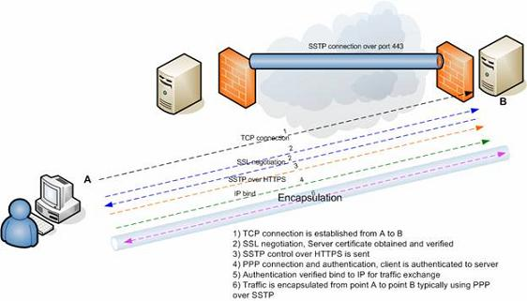
VPN Tunnels
Notes:
DR DT – MPLS VRF routing
SVI

Slide 6
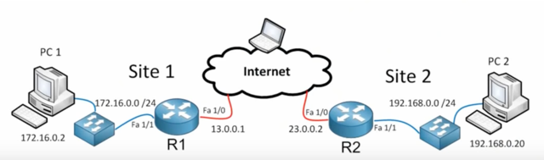
VPN Tunnels Contd.
Notes:
Ipsec VPN: Data confidentiality (Encryption) | Data integrity (Checksum) | Authentication (Data integrity and message authenticity) | Anti-playback ()
VPN cannot traverse NATed networks, but SSL can. Hence an SSL is possible from an endpoint to a network node.
Connectivity will be stable in an SSL VPN. Also the entire session will be secure, whereas with VPN only the tunnel is secure.
SSTP allows multiple synchronous communications between various applications endpoints.
SSTP uses SSL (443) for relaying the traffic. SSTP is only a tunneling protocol unlike SSL which can establish a session.
Reasons for adoption of SSL by SSTP: SSL supports roaming | Do not enforce strong authentication | Client software coding complexities removed
SSTP VPN uses HTTPS to avoid issues due to NAT routers, web proxies, and Firewalls.

Slide 7
Demonstration
Create a Virtual Network in Azure.
Create a couple of VMs.
Establish a Point to Site connection from on-premise lab VM to Azure site (VNet).
Create an Active Directory domain spanning on-premise and Azure DC.
Other test scenarios.

Slide 8
Thank You
raakeshnprakash@gmail.com
+91 99401 86320

